Slide 1


Car sales analysis and prediction
Bootcamp project

Slide 2
Table of content
Context & topic selection
Data cleaning & Machine Learning engineering
Streamlit app
Learnings & challenges

Slide 3
Context & topic selection
Helping a private vendor to estimate his car or a car dealer to follow his statistics,
Solving a business problem,
Creating an app that can be easily personalized and used by a client,
Linked to a database and can be updated,
Showcasing knowledges learnt : Datviz to SQL to Machine learning.

Slide 4
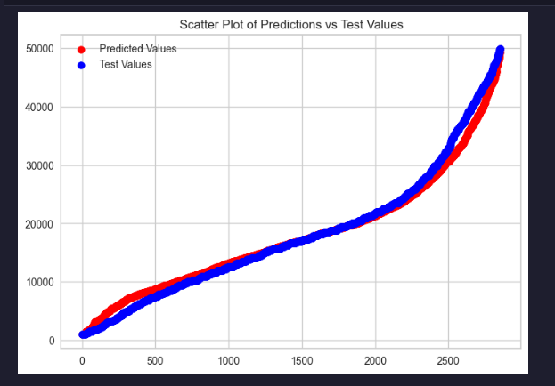
Data cleaning & Machine Learning engineering
180 000km to 180000,
Audi A3 A3 to Audi A3,
Categorical to Numerical,
Target encoding,
Feature encoding,
Binning,
Score 0,78 – Extra Tree Regressor,
MAE 3100$.

Slide 5

Streamlit app

Slide 6
Learnings & challenges
Features relationships,
Topic knowledges,
Machine learning engineering,
Structuring the research process / code,
Deploying the app,
Challenging myself.

Slide 7

THANK YOU
Questions?

